Slide 1


Slide 3
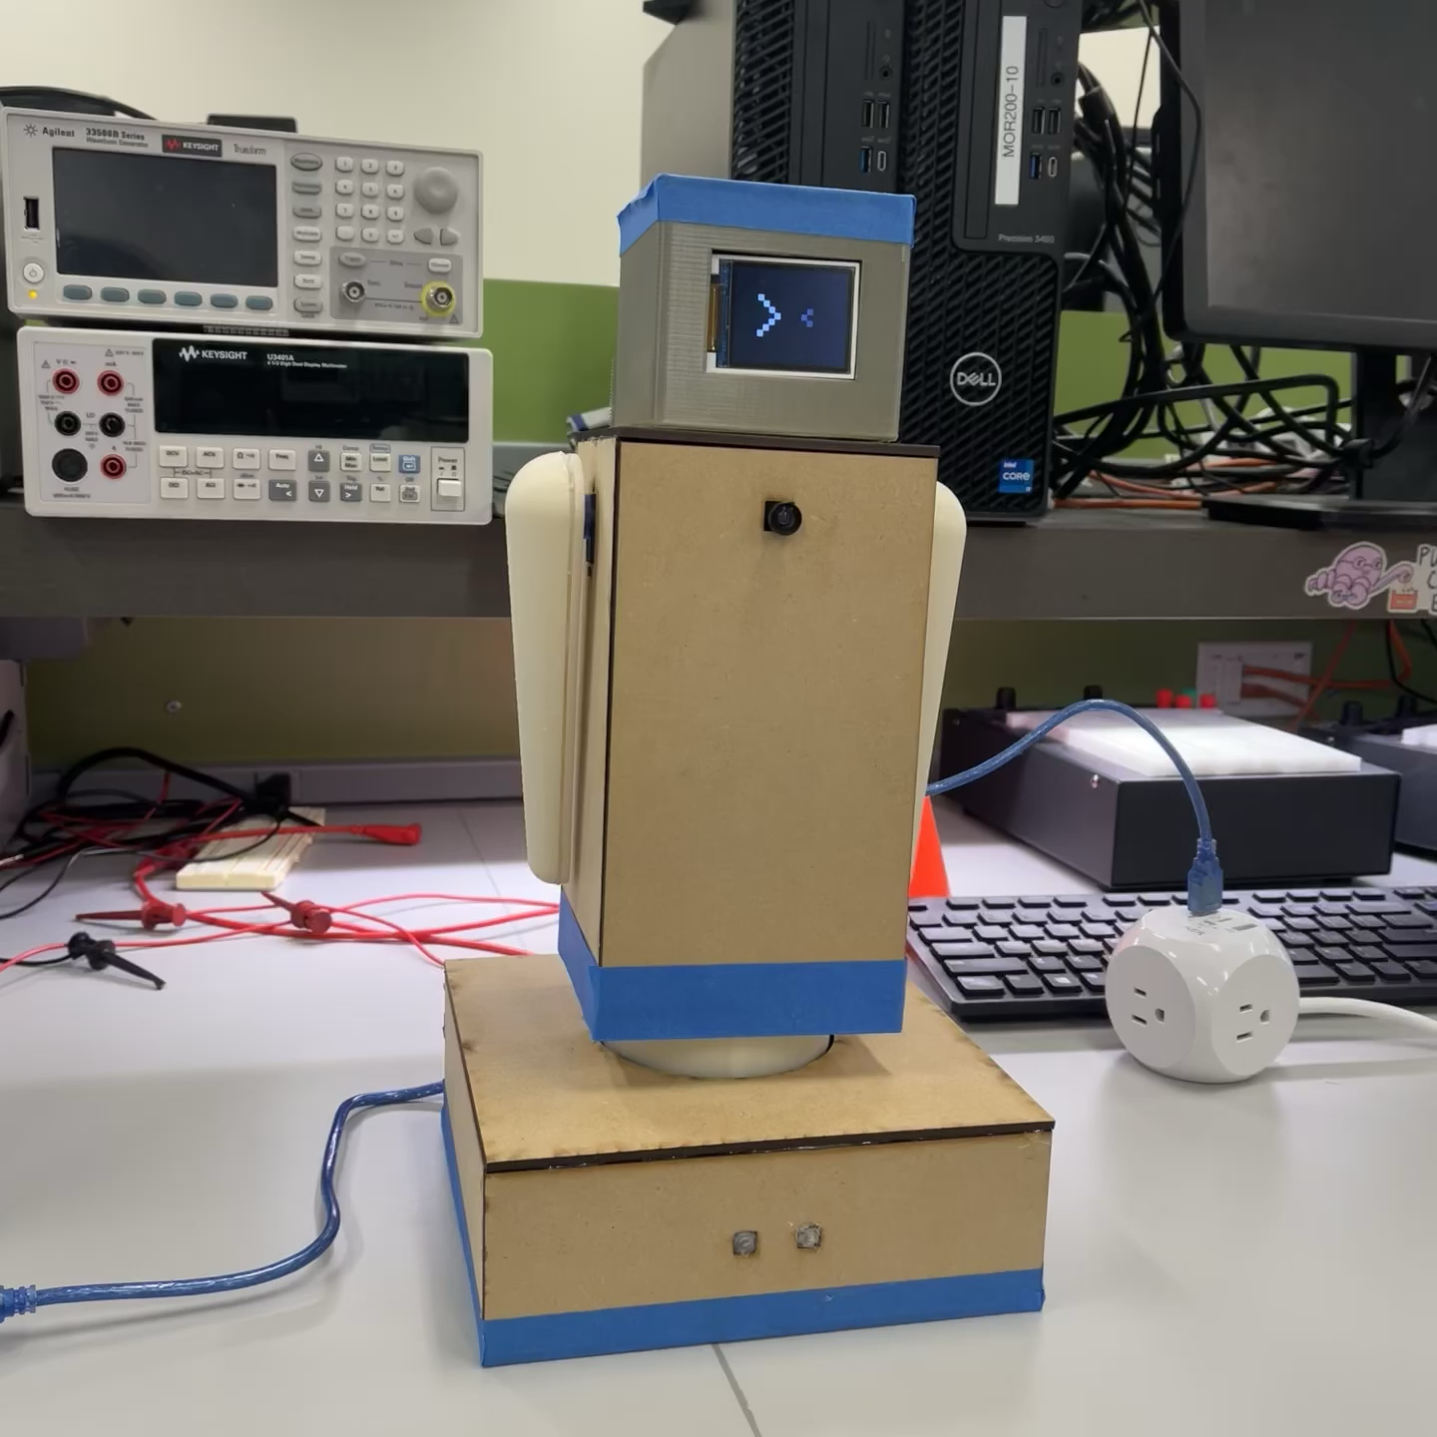

Slide 5
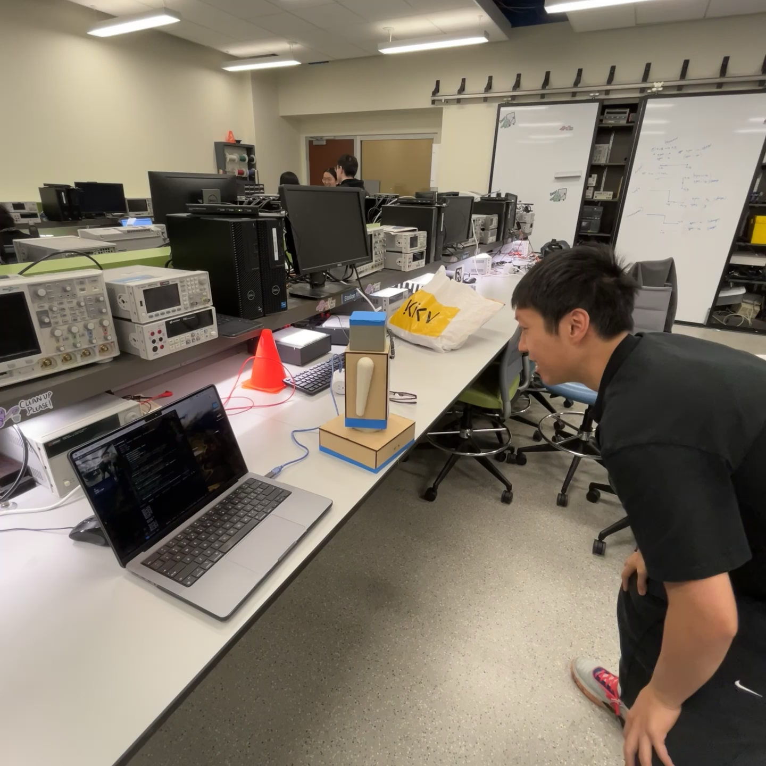
Notes:
In the software side we used opencv library in python, and performed a pretrained face recognition algorithm. After identifying the user's face position, the computer will send the location infromation back to atmega using UART protocol.

